Slide 1
Minimum Spanning Tree
Prim’s Greedy Algorithm

Slide 2
Before explaining the minimum spanning tree
Let’s explain Greedy Algorithms first!!

Slide 3
Greedy algorithms are problem-solving strategies that make locally optimal choices at each stage in hopes of finding a global optimum. These algorithms operate by selecting the best available option at each step without considering the entire problem, making decisions based solely on the current state.
They don’t guarantee Optimal Solutions.
Greedy Algorithms tend to pick the most optimal locally available solution. Hence the word, GREEDY.

Slide 4
Minimum Spanning Tree Prim’s
A spanning tree is a graph tree that has edges connected all around to each other.
e
d
e
d
1
3
1
3
4
4
2
2
a
b
a
b
8
8
4
4
1
1
g
f
g
f

Slide 5
Minimum Spanning Tree Prim’s
A Minimum spanning tree or minimum weight spanning tree is a subset of the edges of a connected, edge-weighted undirected graph that connects all the vertices together, without any cycles and with the minimum possible total edge weight.
e
e
3
3
3
a
2
b
2
2
a
b
a
b
8
4
8
4
4
1
1
1
g
f
g
f
g
f

Slide 6
Back to Minimum Spanning Tree
d
2
e
Rules on The Minimum Spanning tree:
All the vertices should be connected
2) There should be no cycles
3) It should have the minimum weights on edges
1
3
10
4
2
7
a
b
c
8
4
6
5
1
g
f

Slide 7
First Step: Choose a Starting Point
2
Second Step: Keep connecting edges to the point
d
e
Let’s choose A
We connect from point A
1
3
10
4
2
d
e
2
7
b
c
a
b
1
2+1+2+4+1=10
8
4
6
5
2
a
b
As you can see, there are no loops
f
1
g
4
1
g
f

Slide 8
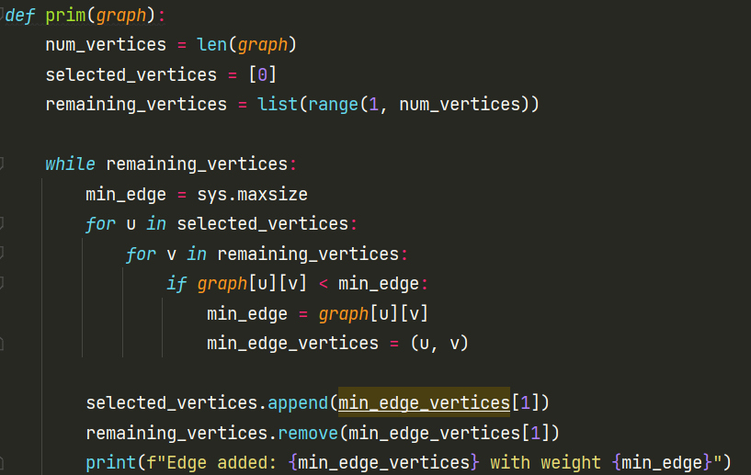
Now let’s check the Algorithm’s code
- num_vertices: Stores the number of vertices in the graph
- selected_vertices: A list that starts with the first vertex (0) which is arbitrarily chosen to be included in the Minimum Spanning Tree.
- remaining_vertices: A list of all other vertices that are not yet included in the Minimum Spanning Tree.
This Implementation assumes you have used an adjacency matrix as your data structure

Slide 9
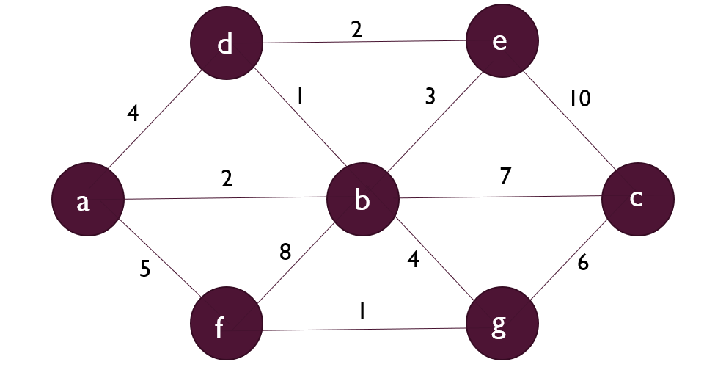
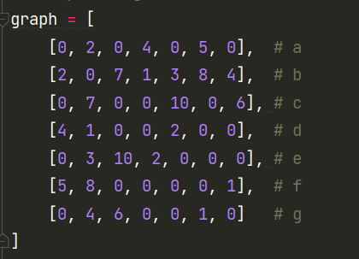
Code Implementation
We used the code from the previous slide and just modeled the graphical representation as an adjacency matrix

Slide 10
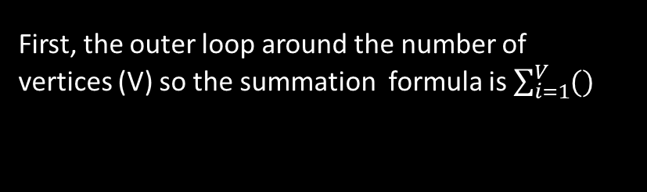
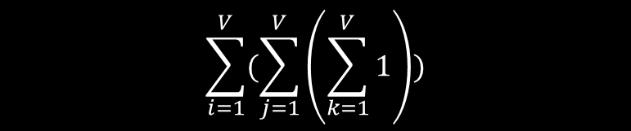
Code Analysis and Time Efficiency
First, the outer loop around the number of vertices (V) so the summation formula is $\sum_{i=1}^{V}{()}$
Secondly, the inner loop iterates over the selected vertices. Let’s say in the worst case it loops through all of them to be added which will be V. In addition, there’s also another loop that iterates through the remaining vertices. Let’s say also in the worst case It loops through all of them which is V. This leaves the equation to be
$$\sum_{i=1}^{V}{(\sum_{j=1}^{V}{\left(\sum_{k=1}^{V}{1}\right)})}$$

Slide 11


Code Analysis and Time Efficiency(cont.)
$\sum_{i=1}^{V}{(\sum_{j=1}^{V}{\left(\sum_{k=1}^{V}{1}\right)})}$
Resolving the innermost summation would be 1(V) = V
$\sum_{i=1}^{V}{(\sum_{j=1}^{V}{\left(V\right)})}$
Now the innermost summation would be evaluated according to this rule , so it would be V*V
$\sum_{i=1}^{V}{(V^{2})}$
We can repeat the same rule again to evaluate
T(n) = $V^{3}$ so this would mean that it’s ${O(V}^{3})$

Slide 12
Thank You For listening

